Slide 1
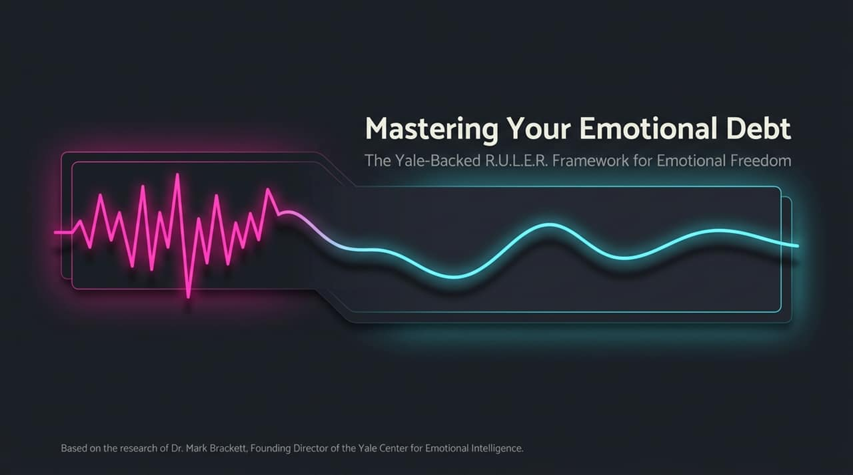
Notes:
Welcome everyone to today’s session on Mastering Your Emotional Debt: The Yale-Backed R.U.L.E.R. Framework for Emotional Freedom, based on the research of Dr. Mark Brackett, Founding Director of the Yale Center for Emotional Intelligence.
Most of us grew up without an emotional education, believing emotions are things we just have to endure or overcome.
Today, we are going to learn how emotional intelligence is not a fixed trait, but a set of learned skills that allow us to use emotions wisely to make better decisions, improve our relationships, and achieve our life goals.
https://www.youtube.com/watch?v=SWvHZkkrAjc

Slide 2
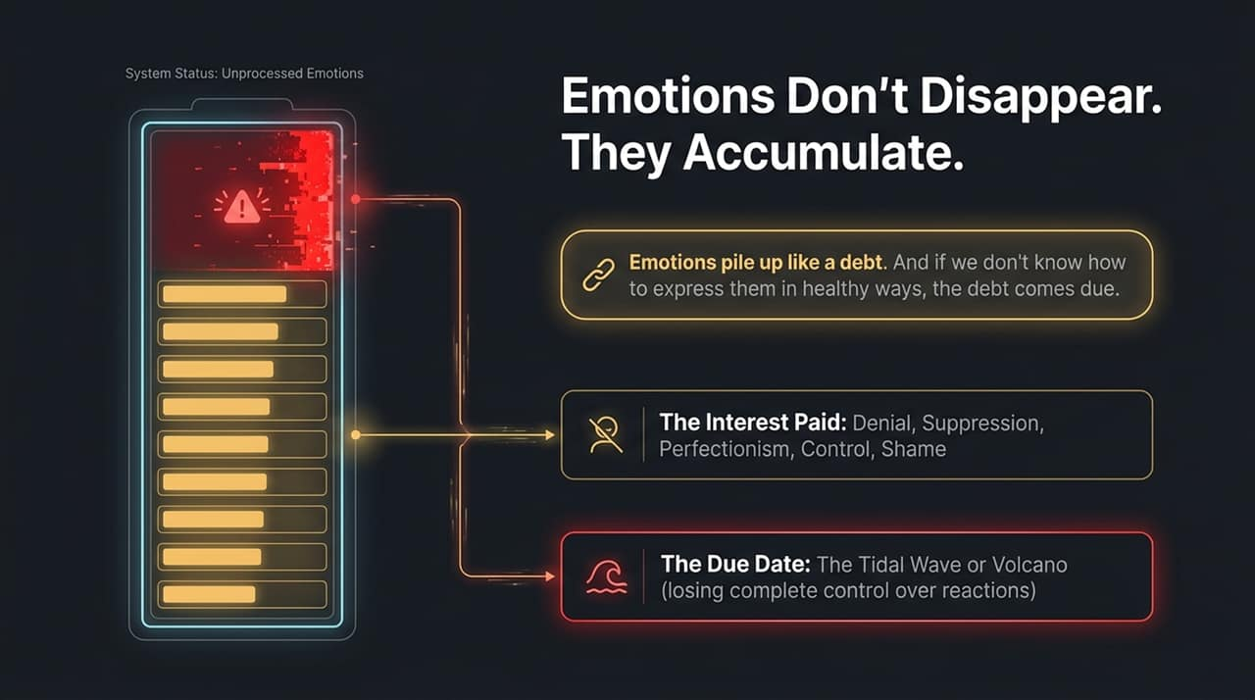
Notes:
As Dr. Brackett highlights, emotions don't simply disappear when we ignore them—they pile up like financial debt.
When we lack healthy avenues for emotional expression, we pay ongoing "interest" through defense mechanisms like denial, suppression, perfectionism, control, and shame.
Eventually, that debt comes due. When we reach our threshold, it manifests as an emotional tsunami or volcano—where we lose total control over our reactions and explode or leak onto others.

Slide 3
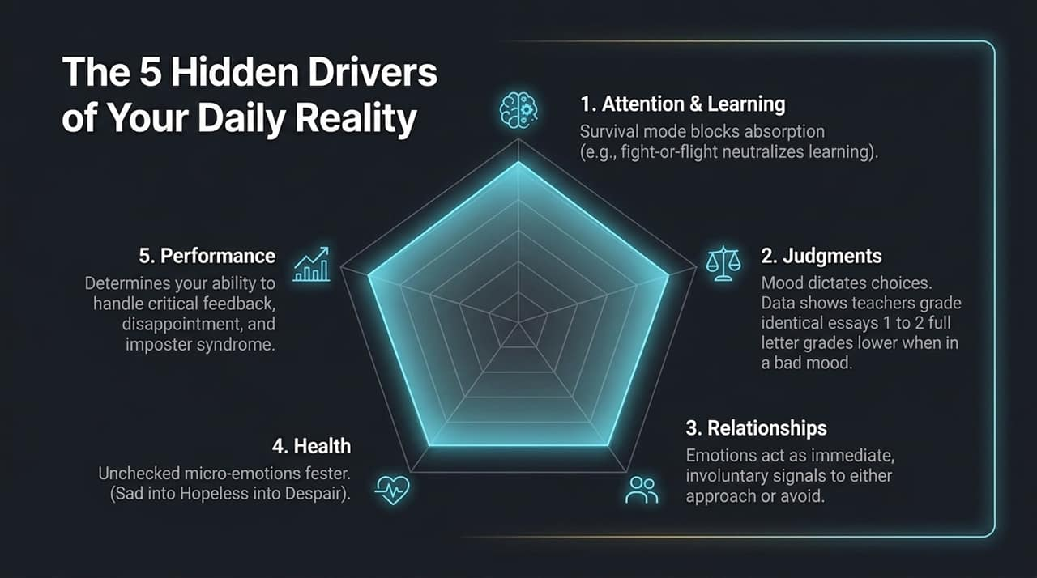
Notes:
Why do emotions matter so much? Research identifies five core areas they dictate daily:
Attention & Learning: High stress or trauma puts the brain in fight-or-flight survival mode, completely blocking absorption and cognitive learning.
Judgments: Mood heavily influences our choices. Studies show teachers graded the exact same essay 1 to 2 full letter grades lower when in a bad mood compared to a good mood.
Relationships: Emotion signals act as immediate, involuntary cues telling others to either "approach" or "avoid" us.
Health: Unaddressed micro-emotions fester over time—sadness degrades into hopelessness, which deepens into despair.
Performance: EQ determines our capacity to handle critical feedback, disappointment, and imposter syndrome without shutting down.

Slide 4
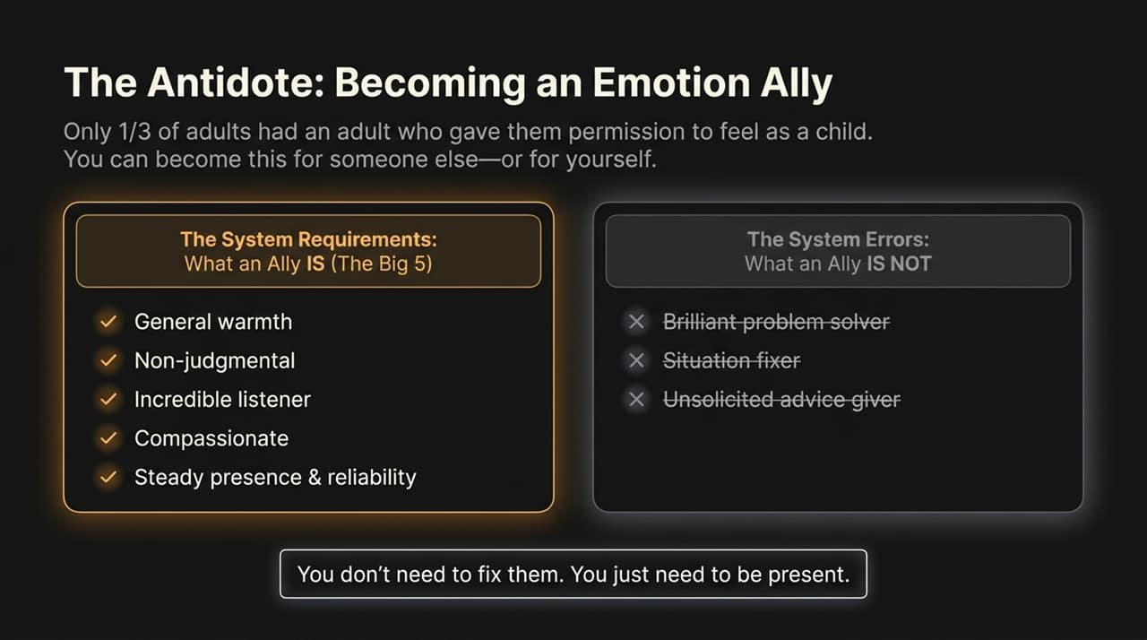
Notes:
Only 1 in 3 adults report having an adult in their childhood who gave them true "permission to feel".
To break this cycle, we can become an "Emotion Ally" for others or even for ourselves.
The System Requirements (The Big 5): An ally offers general warmth, a non-judgmental stance, incredible listening, compassion, and a steady, reliable presence.
System Errors: Notice what is NOT on this list. You do not need to be a brilliant problem solver, a situation fixer, or an unsolicited advice giver. People don't want fixing; they want presence.

Slide 5
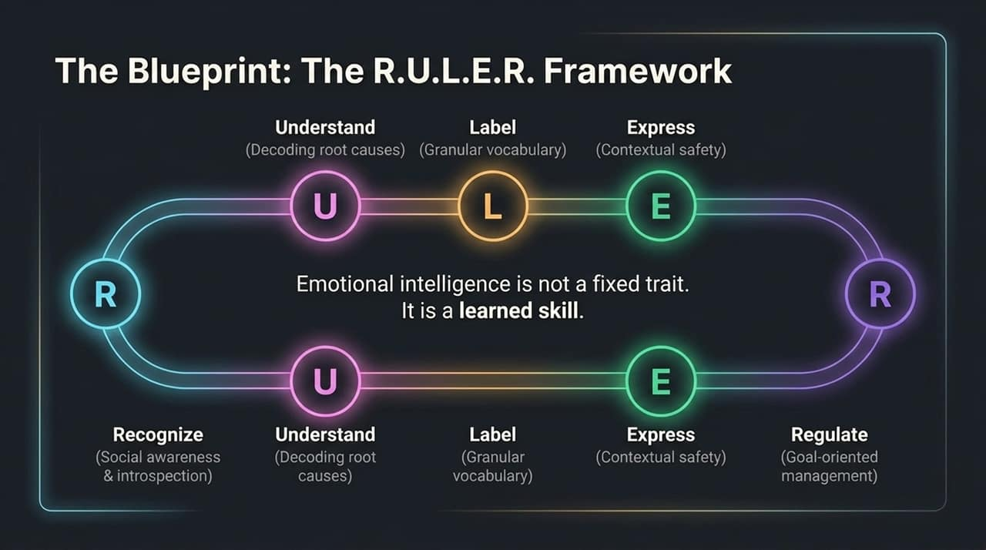
Notes:
To build emotional intelligence systematically, Dr. Brackett developed the evidence-based R.U.L.E.R. framework:
R – Recognize (social awareness and introspection)
U – Understand (decoding root causes)
L – Label (using granular vocabulary)
E – Express (contextual safety)
R – Regulate (goal-oriented management)
Remember: Emotional intelligence is not an innate talent; it is a trainable skill.

Slide 6
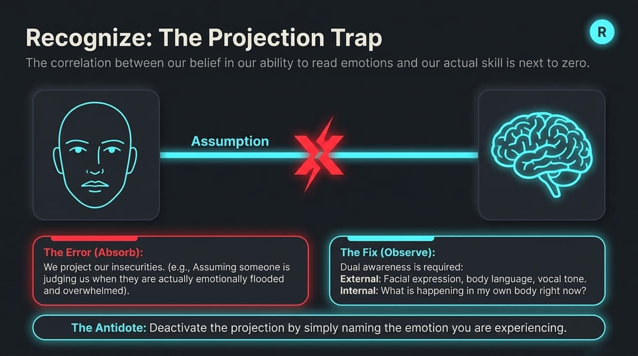
Notes:
When practicing Recognize, beware of the Projection Trap. Research shows that our belief in our ability to read someone else's emotions has almost zero correlation with our actual accuracy.
The Error (Absorb): We project our own insecurities onto others—assuming someone is judging or rejecting us when they are actually just emotionally flooded or overwhelmed.
The Fix (Observe): Maintain dual awareness:
External: Observe facial expressions, body language, and tone of voice without jumping to assumptions.
Internal: Check in with your own bodily sensations.
Antidote: Deactivate projection by simply naming the state you are experiencing.

Slide 7
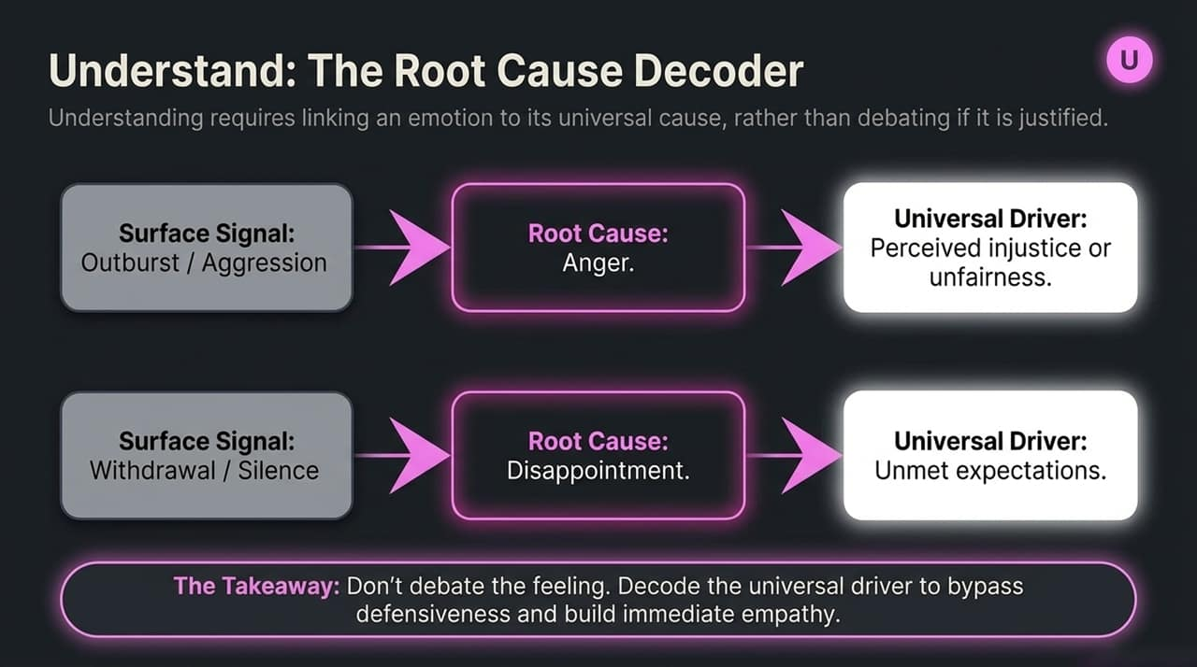
Notes:
Understand means connecting feelings to universal drivers rather than debating whether an emotion is "justified".
For example:
An outburst/aggression stems from Anger, which is universally driven by a perceived injustice or unfairness.
Withdrawal/silence stems from Disappointment, driven by unmet expectations.
Takeaway: Stop arguing over the surface signal. Decode the universal driver beneath it to bypass defensiveness and establish real empathy.

Slide 8
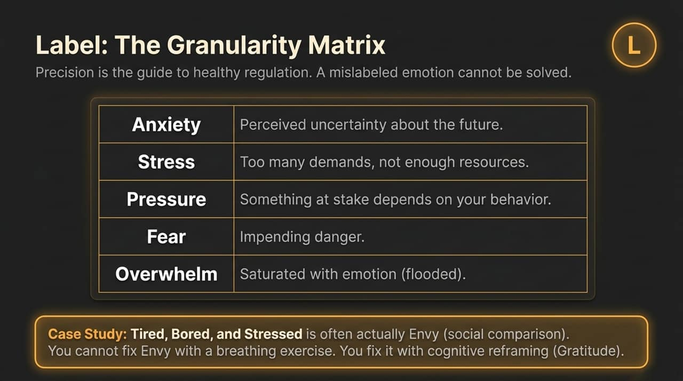
Notes:
Precision is key because a mislabeled emotion cannot be solved accurately.
Distinguish your vocabulary:
Anxiety: Perceived uncertainty about the future.
Stress: Too many demands with not enough resources.
Pressure: High stakes dependent directly on your behavior.
Fear: Immediate, impending danger.
Overwhelm: Saturated or flooded with emotion.
Case Study: Students claiming to be "tired, bored, and stressed" were often actually experiencing Envy due to constant social comparison. You cannot fix envy with breathing exercises—it requires cognitive reframing like practicing gratitude.

Slide 9
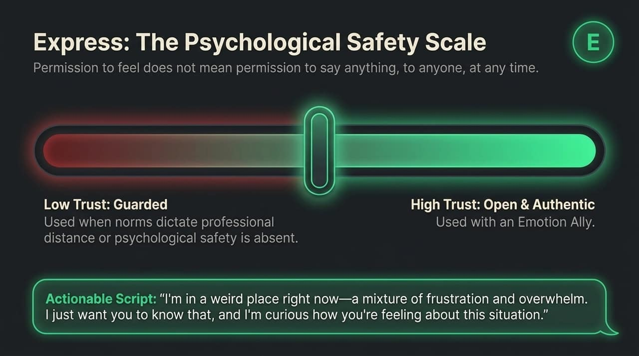
Notes:
Giving yourself "permission to feel" does not mean saying whatever you want, to whoever you want, whenever you want. Expression requires contextual awareness.
Low Trust Environments: Keep responses guarded when workplace norms or lack of psychological safety dictate distance.
High Trust Environments: Practice open, authentic sharing with an Emotion Ally.
Script to try: "I'm in a weird place right now—a mixture of frustration and overwhelm. I just wanted to let you know, and I'm curious how you're feeling about this situation."

Slide 10
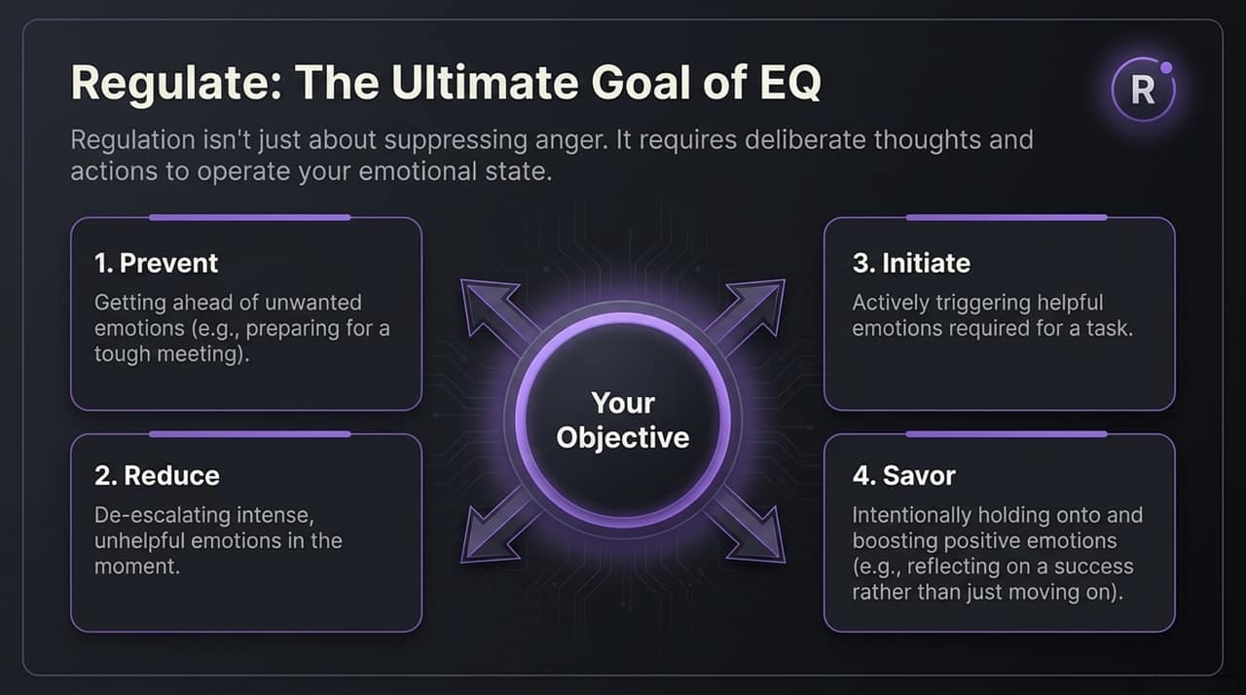
Notes:
Regulation is not merely suppressing anger; it is the deliberate application of thoughts and actions to operate your emotional state.
Effective regulation covers four distinct objectives:
Prevent: Getting ahead of unwanted emotions (e.g., thorough preparation before a difficult meeting).
Reduce: De-escalating intense, unhelpful states in real-time.
Initiate: Actively generating a helpful emotional state needed for a task.
Savor: Intentionally holding onto and amplifying positive emotions rather than rushing past them.

Slide 11
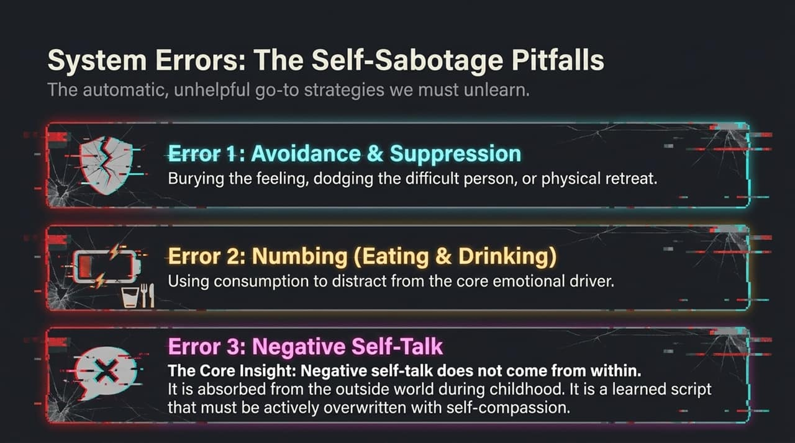
Notes:
To regulate properly, we must unlearn automatic, unhelpful reflex habits:
Error 1: Avoidance & Suppression – Burying feelings or dodging difficult interactions.
Error 2: Numbing – Using food, alcohol, or consumption to distract from emotional drivers.
Error 3: Negative Self-Talk – Critical internal scripts.
Core Insight: Negative self-talk does not originate internally; it was absorbed from exterior sources in early childhood. We must actively overwrite it with self-compassion.

Slide 12
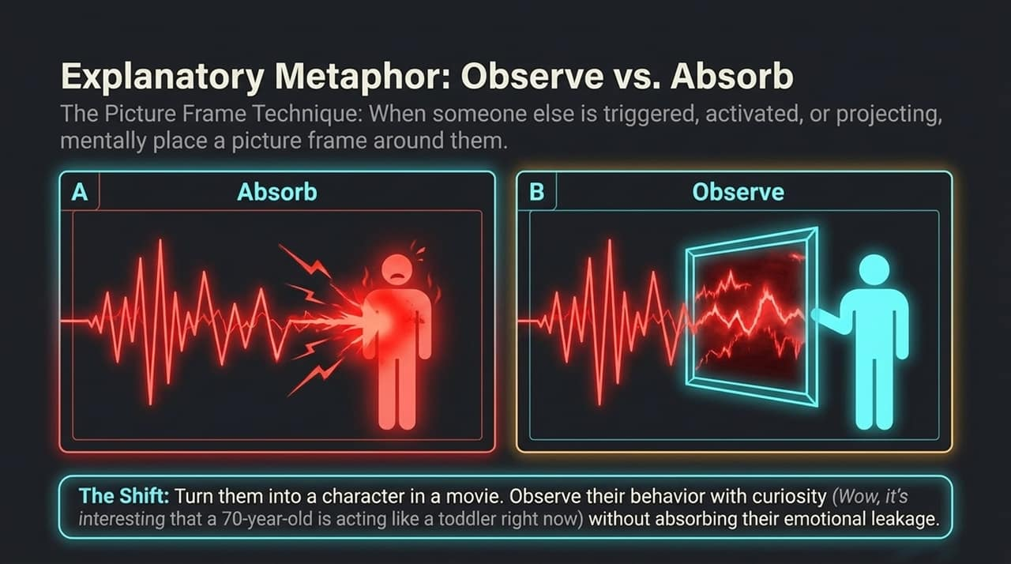
Notes:
When dealing with reactive or triggered individuals, use The Picture Frame Technique.
Instead of Absorbing their emotional leakage into your own body, imagine putting a physical picture frame around them.
The Shift: Turn them into a character in a movie. Shift to curiosity: "Isn't it interesting that a 70-year-old is acting like a toddler right now?" Observe their behavior objectively without absorbing their chaos.

Slide 13
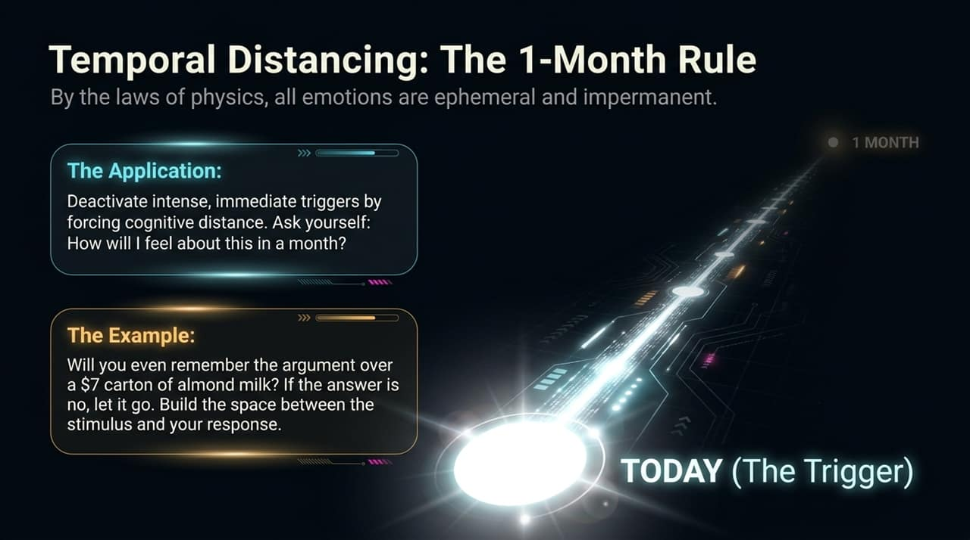
Notes:
Under the laws of physics, all emotional states are ephemeral and impermanent—they are temporary "rainy days."
When triggered, force cognitive distance using Temporal Distancing: Ask yourself, "How will I feel about this in one month?"
Example: Will you care or even remember an argument over a $7 carton of almond milk in a week or a month? If not, let it go and expand the buffer space between the stimulus and your reaction.

Slide 14
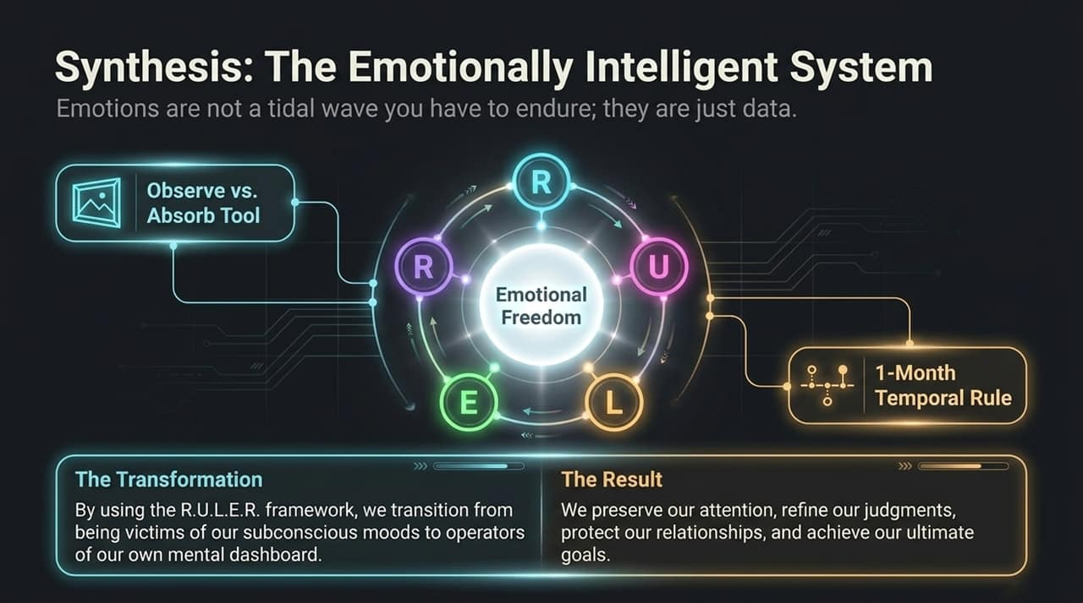
Notes:
Emotions are not tidal waves to be feared—they are simply incoming data.
By integrating R.U.L.E.R. with practical tools like Observe vs. Absorb and the 1-Month Rule, we shift from being passive victims of our subconscious moods to active operators of our emotional dashboard.
The outcome: preserved attention, refined judgment, healthier relationships, and achieved personal goals.

Slide 15
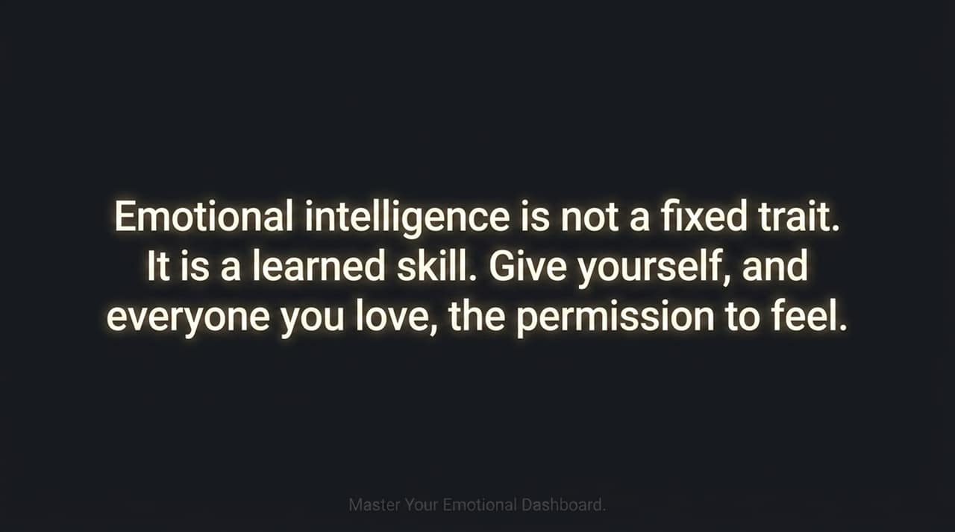
Notes:
Let's review the summary matrix:
Why Emotions Matter: They drive decisions (e.g., essay grading variations), impact learning by putting us in or out of survival mode, and serve as approach/avoid social signals.
RULER in Practice: Recognize physical cues, Understand root drivers (like injustice), Label precisely (distinguishing stress from anxiety), Express safely, and Regulate intentionally.
Key Mindsets: Observe rather than absorb, and embrace the impermanence of emotional states.

Slide 16
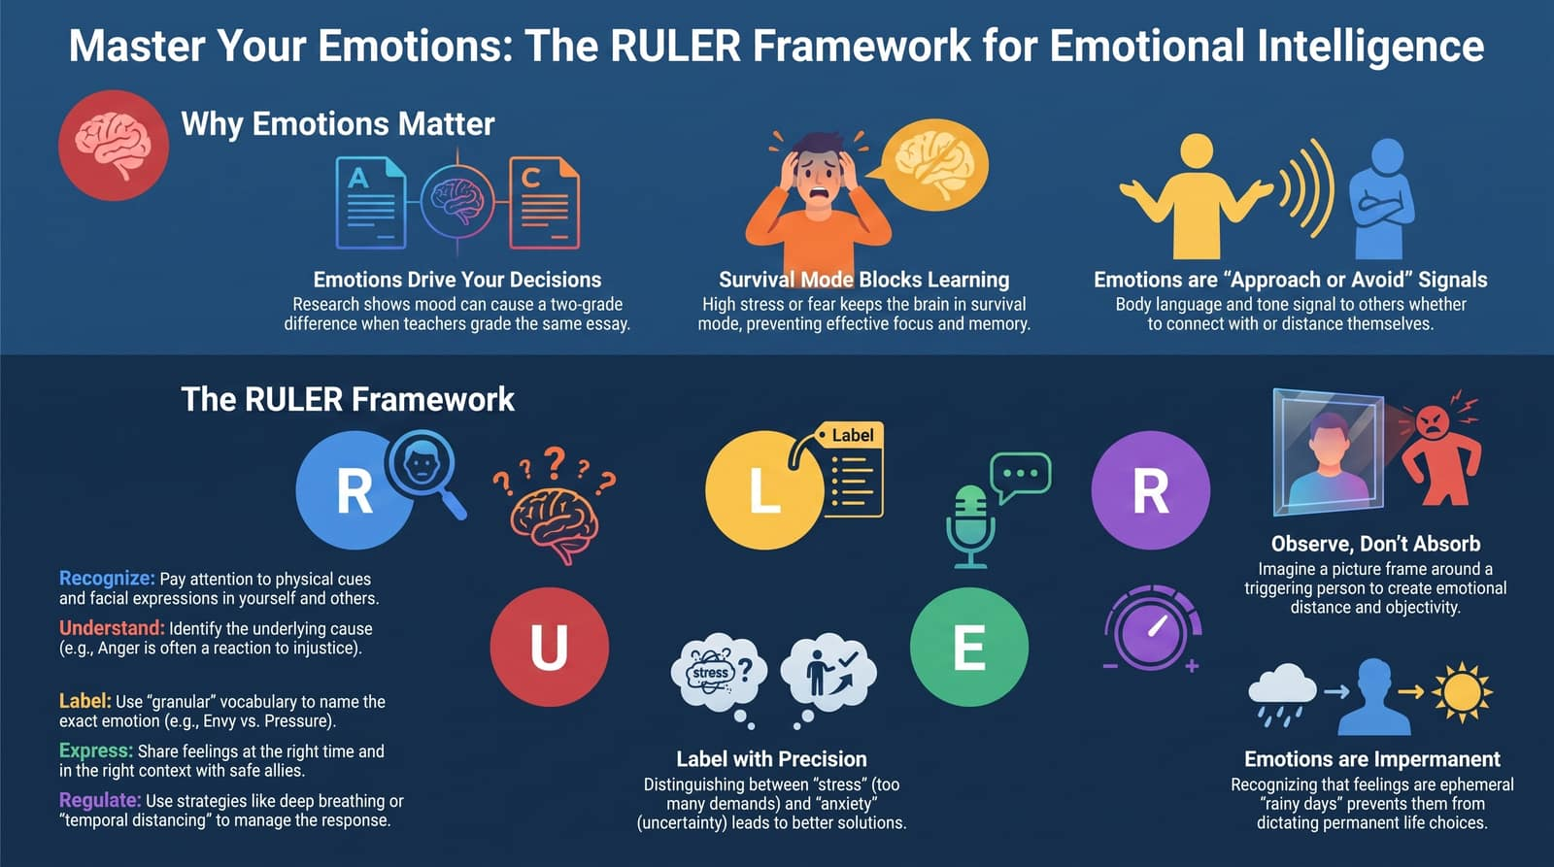
Notes:
As Dr. Brackett concludes, emotional intelligence is not a fixed trait. Today is the first day of the rest of your life to begin practicing.
Give yourself—and everyone you interact with—the permission to feel.
Thank you for your time and commitment to mastering your emotional intelligence.

